Slide 1
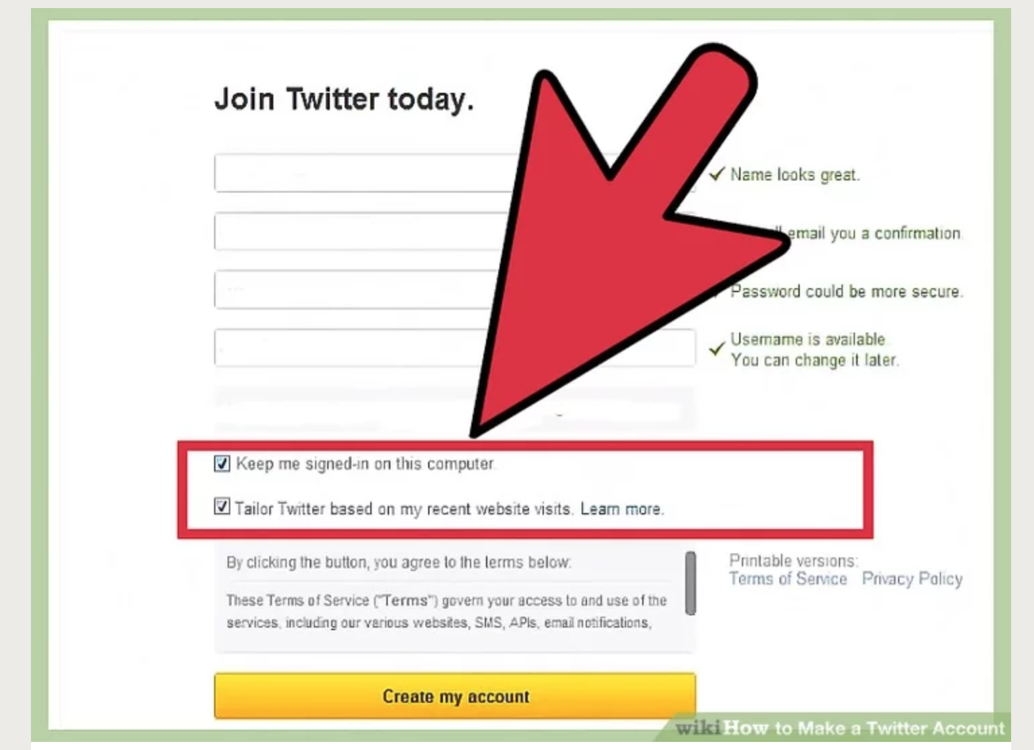
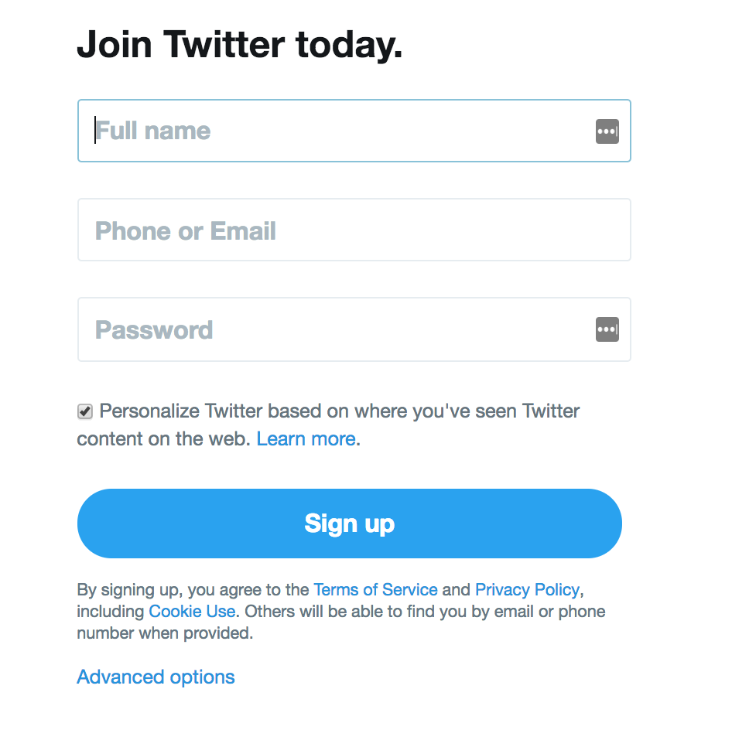
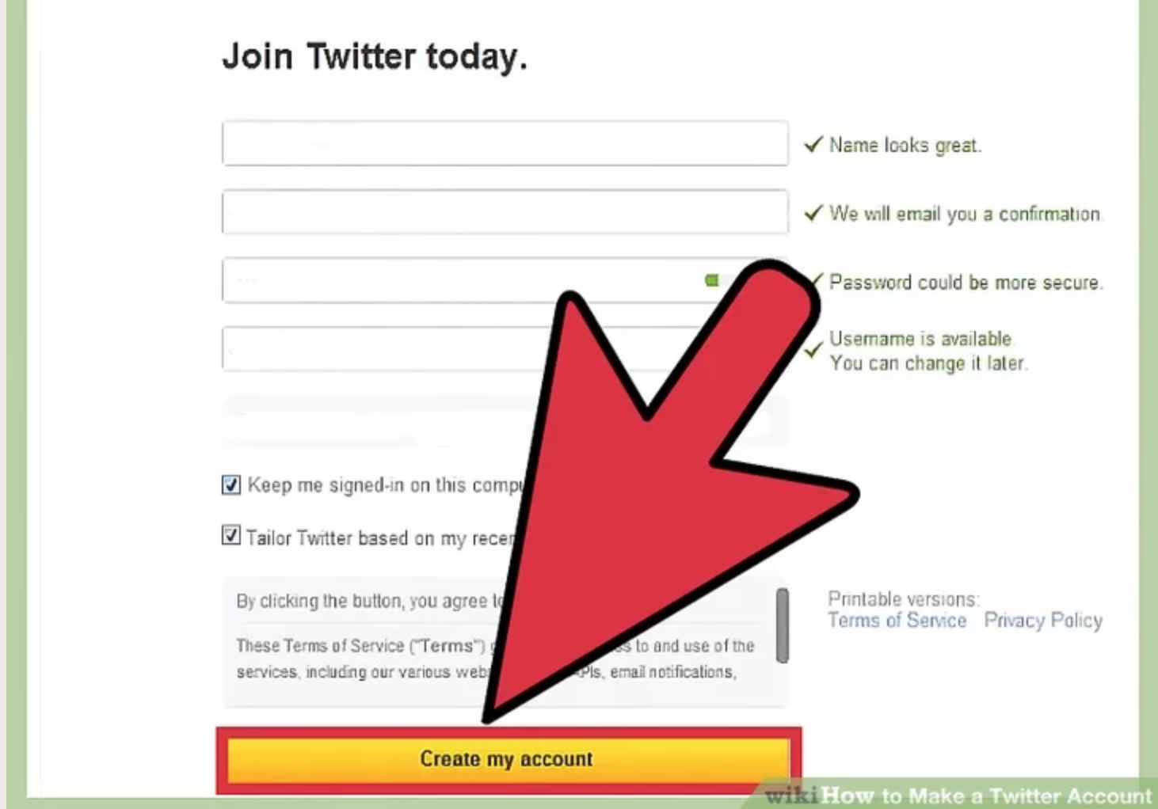
How to Create a Twitter Account
5. Decide whether you want to be signed in to Twitter on the device you’re using. If it’s your own computer, this is a good option. If not, then you should uncheck the box next to this option.
6. Click “Create my account.”
ACSA social media resources can be found at: acsa.org/socialmedia
1. Go to www.twitter.com
2. Click “Sign Up” button
3. Provide basic info about yourself. Click “Sign Up.”
4. Choose your username. It can be up to15 characters long. Follow the prompts.

